Slide 1
Group 13 – Project Presentation Ermesa Pepe, Bryan O’Donohoe, Marcin Starzyk X20212887, X20212828, X20212836 School of Computing, National College of Ireland Mayor Street Lower, International Financial Services Centre, Dublin, Ireland

Slide 2
Group 13 – Project Presentation
Overview
Architecture of Technologies & Flows of Data
Diagram of Data Flow
UI
FIFA Analytics
Meat Consumption

Slide 3















Architecture of Technologies and Flow of Data
1. Retrieval of semi-structured data
2. Storing Data in MongoDB
3. Reading Data from MongoDB
4. Creating structured DataSet
5. Storing DataSet in PostgreSQL
6. Retrieving DataSet from
PostgreSQL
7. Data Analysis
2
3
5
5
3
6
6
5
6
4
2
2
7
Dataset: Countries Population
Method: Web Scraping
4
4
Marcin
Bryan
Ermesa
1
Dataset: Obesity Data
Method: HTTP Call
Format: XML
Dataset: Fifa 19 Players
Method: Web Scraping
Dataset: Meat Consumption
Method: HTTP Call
Format: csv
Dataset: Covid Data
Method: API Call
Format: JSON
1
1

Slide 4
Diagram of Data Flow
Bryan
Dataset: Fifa 19 Players
Method: HTTP Call
Format: CSV
Dimensions: 18206 x 89
Database: bryan_db1
Collection: fifa_player_rating
Documents: 1879
Number of fields: 91
DB name: dap
Ermesa
Table: fifa_summary
Rows:39
Columns:6
Dataset: Meat Consumption
Method: HTTP Call
Format: csv
Dimensions: 292839 x 60
Database: ermesa_db
Collection: meat_data
Documents: 292839
Number of fields: 12
Collection: meat_historic_data
Documents 238650
Number of fields: 60
2
Table: meat_cons
Rows:18560
Columns:11
Table: final_table
Rows:33
Columns:12
Marcin
Dataset: Covid Data
Method: API Call
Format: JSON
Dimensions: 192x5
Database: marcin
Collection: covid_data
Documents 192
Number of fields: 5
Collection: population_data
Documents 235
Number of fields: 2
Collection: obesity_data
Documents: 191
Number of fields: 2
Dataset: Countries Population
Format: LXML (WebScraping)
Dimensions: 235x11
1
Table: covid_bmi
Rows:39
Columns:5
Dataset: Obesity Data
Method: HTTP Call
Format: XML
Dimensions: 195x126
Note: final_table contains the list of OECD countries + China and India.

Slide 5
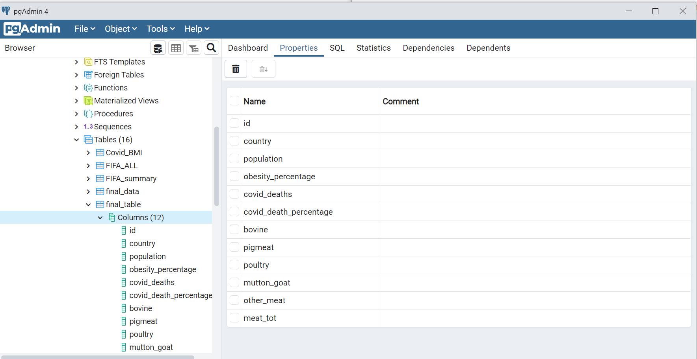
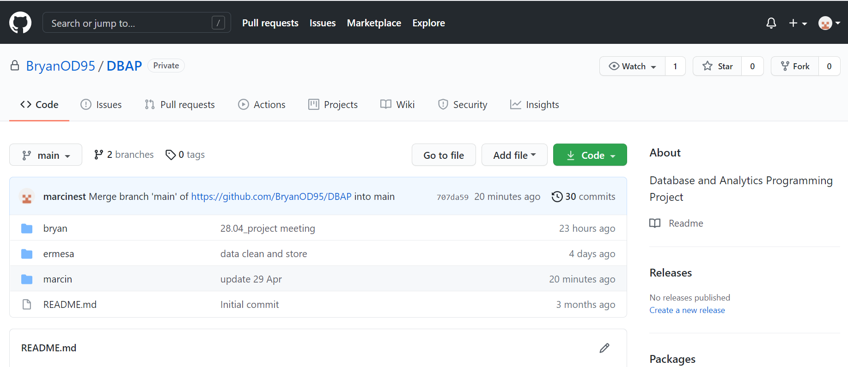
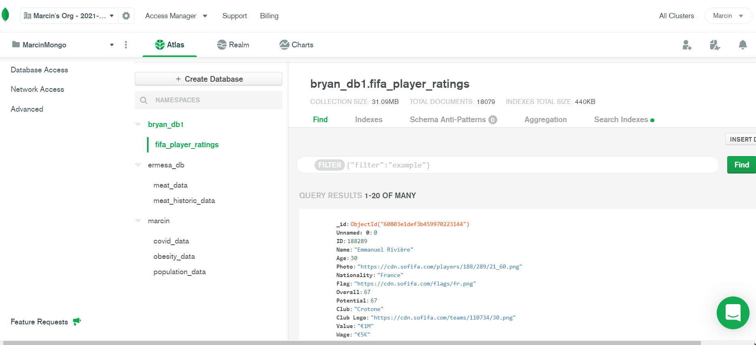
Screenshots of UIs

Slide 6
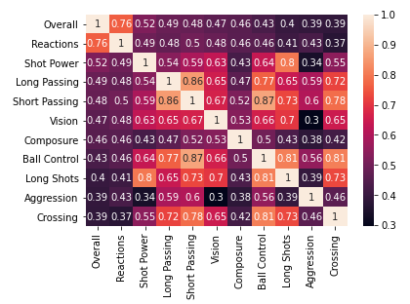
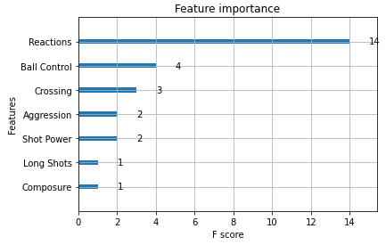
FIFA Analytics
Correlation matrix indicates that “Reactions” is the factor highest correlated with “Overall” rating
Fitting a Gradient Boosted Machine to the data indicates that “Ball Control” is the second most significant factor in determining “Overall” rating when controlling for all attributes

Slide 7
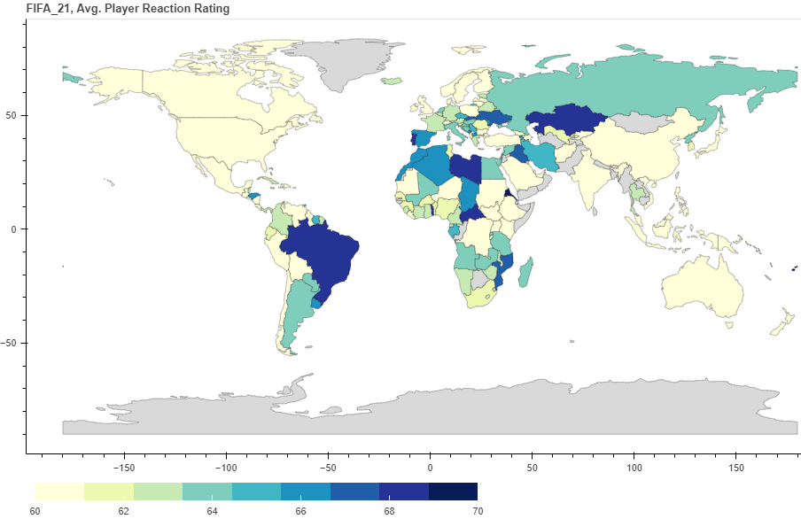
FIFA Analytics
Graphed here is the average “Reactions” rating for each country
Brazil, Portugal and Spain among the highest scores of countries with a credible number of observations

Slide 8

Process for Data Quality
For the scope of 2 dataset are selected to conduct analysis http://www.fao.org/faostat/en/#data/FBS
Processing for data quality:
Data collection Data filtering
Data cleaning
Data transforming
Visualisation and results
Data | Food Balance Dataset
 | Unit Measure | Time Coverage
Food Balance1 | Export Quantity[1000T] Import Quantity[1000T] ProductionQuantity[1000T] Food Supply Quantity[kg/capita/yr] | 2014-2018 Size 7.2 MB Rows:292.839 Columns:12
Food Balance2 | Export Quantity[1000T] Import Quantity[1000T] ProductionQuantity[1000T] Food Supply Quantity[kg/capita/yr] | 1961-2018 Size 25.49 MB Rows:238.560 Columns:60
Tools used
Azure VM with Debian OS
MongoDB Atlas
PostgreSql
Jupyter Notebook
Github
https://github.com/BryanOD95/DBAP/tree/main/ermesa
Programming languages python 3.9.1, json. css, html,
Data quality is a fundamental aspect and can be compromised by: Missing values, Noise(This distortion of the data), Outliers, Duplicates

Slide 9
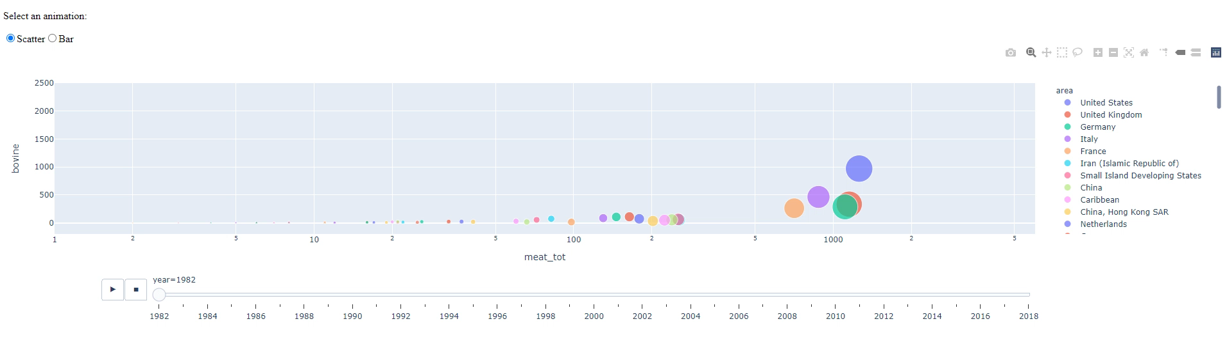
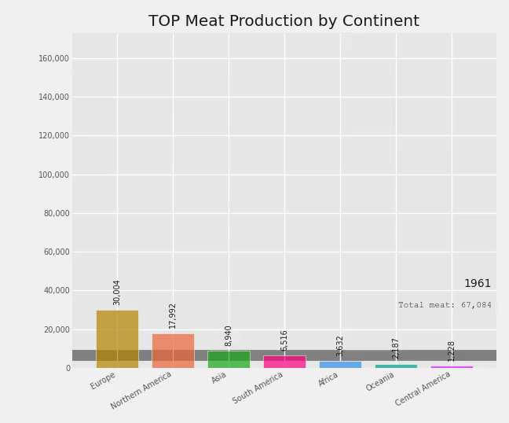
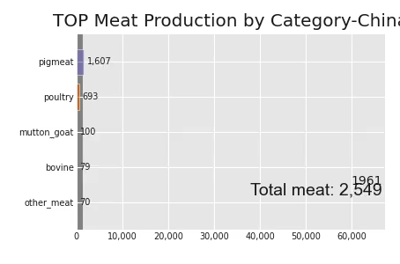
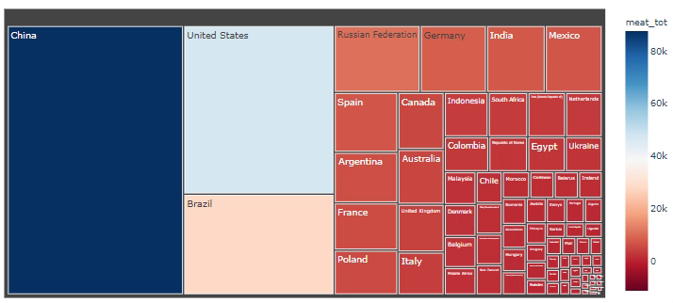
Example of use of library Matplotlib, Seaborn and Plotly, Jupyter-Dash, Altair
Data visualization
with Bar Race
Animation Using Jupyter-Dash
TreeMap-World Meat Production in 2018
China Case Meat produced (1961-2018)
Since many of the data are difficult to understand as they are, both because they are in large quantities, and because often without being able to compare them with others, it is difficult to understand their meaning, it is very effective to take this data and use it for the graph construction

Slide 10
Finding merging with the other datasets
Matplotlib, Seaborn, and Plotly are unique in their own way. Also, a few other libraries like Altair, ggplot, and Pygal have been tested and are suitable for data visualisation.
Seaborn has been very useful for static views with Plotly and Jupyter-Dash for highly interactive web-embedded views.
United States is the world's largest bovine meat producer
China is the world's largest, producing around 55 million tonnes of pig meat in 2018
Brazil is one of the largest beef exporters globally, mainly destined for the Chinese
The graphs and dashboards created are a picture of the historical moment we are living in. The population number is growing and the demand for meat is increasing rapidly. Still is evident a considerable difference with developing countries
The USA and Australia are the top countries in meat consumption and obesity (kg\Capita\Year)
Preference to import meat from low-cost countries or delocalised production to increase profit.
No direct correlation directly between Covid19
More deep consideration based on recent researches
Among the potential transmission factors of zoonoses are long-distance transport and the vast supply chain used by the agri-food industry and already shown in the data analysed as meat trade.

